Slide 1
Project Overview Presentation
on
Currency Converter
Presented
by
Prateek Bhambri (1811981227)
Varun Malhotra (1811981342)
Sawan Sood (1811981282)
Under the supervision
of
(Dr. Ashutosh Kumar Dubey and Ms. Ravita Chahar)
Department of Computer Science and Engineering

Slide 2
Contents
Introduction
Objective(s)
Problem Statement(s)
Real Life Applicability
Dataset
Tools/Methods
Description of the Contribution

Slide 3

Introduction
The currency converter will return what the conversion multiple is. The conversion multiple means 1 USD is equal to 74.23 INR. The currency converter service will convert one currency to another. Suppose the currency converter service wants to convert 100 USD
to INR. So it will convert
the specified amount and
provide the required output.

Slide 4

Objectives
It will accept one numeric value
for currency to be converted
and input choice to choose
two currencies that one’s want
to convert.
It will convert one currency into another currency after taking input.

Slide 5

Problem Statement
We have been given a scenario
that asks us to design a working
currency converter that will be
introduced into the HSBC bank
system, this converter will have
to have at least 5 currency types. The converter
will have to be able to convert a typed in amount
from one currency to another that will be chosen
by the user beforehand.

Slide 6
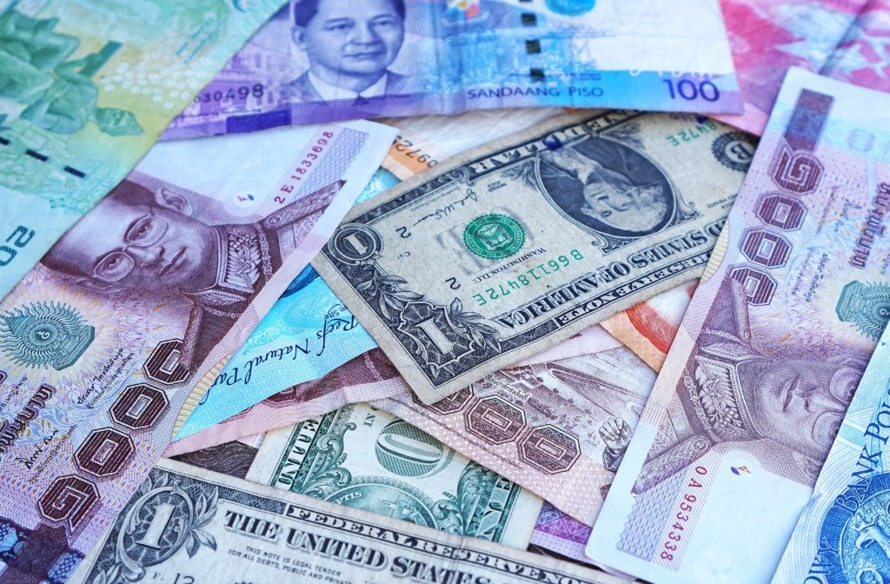
Real Life Applicability
When people shop from a store in another country, a currency exchange occurs when they change the money they have into the money format used in the country they are shopping in.
Currency converter that the people are using, they will always find ways to get the highest possible profits out of the exchanges. To those who are going to travel, it is a wise thing to check the different foreign exchange option they have beforehand.

Slide 7
Dataset
USD | INR | CAD | AUD | DIRHAM
1 | 74.2391 | 1.3004 | 1.3716 | 3.67
100 | 7423.91 | 130.04 | 137.16 | 367.30
599 | 44482.70 | 779.20 | 821.62 | 2200.11
9999 | 742491.74 | 13007.05 | 13714.55 | 36726.03

Slide 8



Tools/Methods

Slide 9
Description of the Contribution
Prateek Bhambri
(Data Collection)
Varun Malhotra (Database)
Sawan Sood (Development)

Slide 10
THANK
YOU

